Slide 1
TELE-DOC
GROUP NUMBER 22
GROUP MEMBERS
NAME | REGISTRATION NUMBER
NAKIRAGWA LETICIA NAKITY | 2023/ITB/DAY/1706/G
LUBWAMA MARVIN ESUKA | 2023/ITB/DAY/0632
MARACTHO JOHN BOSCO | 2023/ITB/DAY/1005
KIKULE AUGSTINE | 2023/ITB/DAY/1365
LEPI DENISH | 2023/ITB/DAY/0628
KAPERE INNOCENT | 2023/ITB/DAY/0939
SUPERVISOR NAME: MR. NKURUNNUGI EDISON

Slide 2
BACKGROUND OF THE STUDY
The rapid advancement of technology has revolutionized various sectors, and healthcare is no exception. Traditional healthcare models, often characterized by physical clinic visits, are increasingly becoming less efficient and accessible. This is particularly true for individuals residing in remote areas of Uganda, those with mobility limitations, and those with busy schedules. Telemedicine, the delivery of healthcare services through telecommunication technologies, offers a promising solution to these challenges

Slide 3
STATEMENT OF THE PROBLEM
Many individuals, especially in rural and underserved areas, face significant barriers to accessing quality healthcare services.
The cost of healthcare services, including transportation and time off work, can be prohibitive for many.

Slide 4
GENERAL OBJECTIVE
To develop a mobile App that will help provide remote access to quality health care services.

Slide 5
SPECIFIC OBJECTIVES
To study the current system used.
To analyze and correct data.
To design system with the required data.
To develop a user-friendly online platform.
To test and validate the system.

Slide 6
SCOPE OF STUDY
The system deals with medical health care services offered by Ruby hospital in Kampala.
TIME SCOPE
Project timeline: The project is expected to be completed within one year (12 months)
GEOGRAPHICAL SCOPE
The system was built for use by the people in the rural areas of Uganda.

Slide 7
SCOPE OF STUDY
TECHNICAL SCOPE
The system interface was created with user-friendly features and Tele-Doc will provide real-time consultations between patients and healthcare professionals. The system will be connected to the cloud to store data (e.g., menus, messages) and could be retrieved anywhere at any time.

Slide 8
SIGNIFICANCE OF THE STUDY
MANAGEMENT
The “Tele-doc” system helps health professionals to track appointments and schedules, manage consultations and enable make appropriate decisions for efficient service delivery. .
USERS
The system makes it easy for patients to log in and find information on available medical services at any time.

Slide 9
SIGNIFICANCE OF THE STUDY
GENERAL PUBLIC
The system benefits the general public by providing a platform for consumers to consult, making it easier to find reliable and quality services.
RESEARCHERS
The system will help future researchers to discover system functionalities and use it in their work to improve or develop a system that may be of better use or for system integrations.

Slide 10
JUSTIFICATION OF THE STUDY
CONVICTION
Every medical platform has a unique menu and service style, which can be presented to consumers through “Tele-Doc”. Consumers makes informed decisions and finds the best medical services meeting their needs, increasing customer satisfaction and trust in the health sector.

Slide 11
LITERATURE REVIEW
STATE OF PRACTICE
Tele-doc services let people talk to doctors remotely using phones, apps, or messages . They help with common illnesses, mental health, and managing long-term conditions. These services are growing fast, especially in cities, and often connect with health records and pharmacies. But in rural areas, poor internet and low-tech access are still big challenges. Rules and insurance support are improving, and new tools like health wearables and smart apps are making care even easier.

Slide 12
STATE OF ART SIMILAR EXISTING SYSTEMS.
Recently telemedicine platforms have provided virtual consultations, prescription management, and mental health support. Similar systems have been developed such as MDLive, Amwell, plushcare. However, Tele-Doc project is to enable Internet of Thinks (IoT) which integrates with wearable devices and IoT devices to enable remote monitoring and tracking.

Slide 13
COMPARATIVE EVALUATION
System type
 | Features | Functionality | Cost |  | Quality |  | Customer support |  | Security. |  | Integration with wearable devices.
Teladoc | YES | YES | YES |  | YES |  | YES |  | YES |  | NO
American well | NO | NO | YES |  | NO |  | NO |  | NO |  | NO
MDLive | YES | YES | YES |  | YES |  | YES |  | YES |  | NO
Tele-Doc | YES | YES | YES |  | YES |  | YES |  | YES |  | YES

Slide 14
METHODOLOGY
INTERVIEWS
We conducted interviews with patients in the hospital and health experts in Kampala to gather information on their needs, preferences, and experiences. These interviews provided firsthand information and helped us diversify our data collection.
OBSERVATIONS
We observed the current operations of health care service providers in Kampala, including their consultation processes, and patients’ interactions with doctors. These observations provided factual information for system development.
DOCUMENT REVIEW
We thoroughly reviewed existing documents, such as reports, books and patients’ feedback, to identify requirements and challenges in the current system.

Slide 15
SOFTWARE TOOLS
Data analysis tools
Tele-medicine platform
Electronic health records

Slide 16
HARD WARE TOOLS
Computers
Smartphones
Laptop

Slide 17
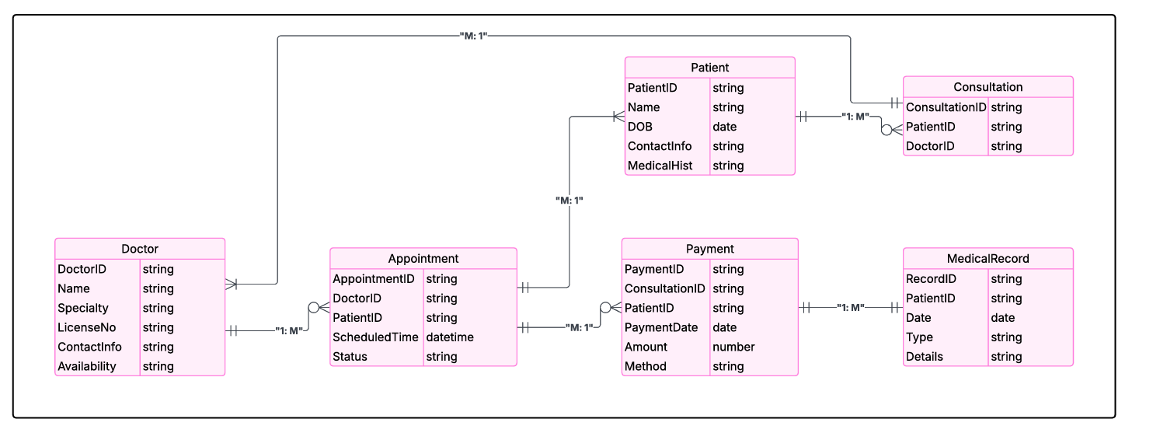

SYSTEM CONSTRUCTION/ SYSTEM ANALYSIS & DESIGN
ENTITY RELATIONSHIP DIAGRAM (ERD)
The ERD illustrates the entities and their relationships within the database, showcasing the data structure and how different data entities are interconnected.

Slide 18
SYSTEM CONSTRUCTION/ SYSTEM ANALYSIS & DESIGN
DATA FLOW DIAGRAM (DFD)
The DFD provides a more detailed depiction of data flow throughout the system. It serves as a breakdown of the context diagram, highlighting how raw data moves through the system, is processed, stored in various locations, and managed by different user roles.
Medical records
doctor
Tele-doc
patient

Slide 19
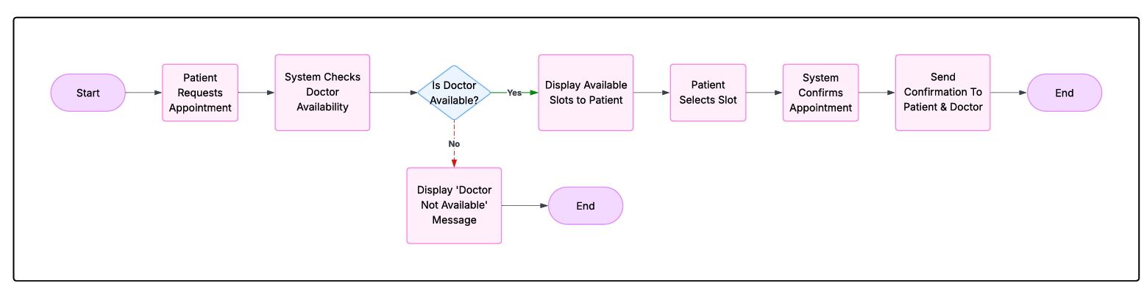
SYSTEM CONSTRUCTION/ SYSTEM ANALYSIS & DESIGN
PROGRAM FLOWCHART.
This shows how patients move through the system from start to finish, and how different systems interact.

Slide 20
PROTOTYPE TESTING AND VALIDATION/ SYSTEM TESTING AND VALIDATION
UNIT TESTING
Focuses on testing individual functions/methods.
Typically done using testing libraries like Jest (JavaScript), JUnit (Java).
COMPONENT TESTING
Focuses on testing individual UI components and their interaction with props/state.
Common in front-end frameworks like React (tested with React Testing Library, Enzyme, etc.)
Feature | Type of Test | Description
Login System | Unit Test | Validate email/password function and error handling
Messaging Component | Component Test | Simulate text session state, check
Appointment Booking Form | Unit + Component | Validate input fields + render logic
Chat Functionality | Unit Test | Send/receive message logic, text input
Doctor Availability API | Unit Test | Mock API response, check filtering logic

Slide 21
Block testing refers to testing interconnected modules or functional blocks of a system together, rather than testing only individual units or the entire system end-to-end. It’s mid-level testing, often used in system prototyping.
Block | Includes | Test Focus
User Authentication Block | Login, Signup, Token Validation | Credential flow, session state
Appointment Management Block | Booking, Scheduling, Rescheduling | Time validation, calendar logic
Communication Block | Messages/ Chat | Media streaming + message delivery
Doctor Availability Block | Fetching and filtering doctor schedules | API calls, time zone handling

Slide 22
System testing (also called final prototype testing) is the last phase of testing before deployment. It verifies that the entire application works as expected in a complete and integrated environment.
Area | What We Tested | Goal
End-to-End User Flow | Patient registers, books an appointment | Confirm the full journey works smoothly
Cross-Module Integration | Login ↔ Booking ↔ Notification ↔ message | Ensure seamless data flow and UI transitions
Performance Under Load | Simulate multiple users booking/joining at once | Identify lag, crashes, or backend limits
Security Tests | Auth token misuse, invalid access, role restriction | Ensure patient/doctor privacy and data protection
Mobile/Desktop Compatibility | Different devices, browsers | Ensure responsive design and functionality
Failure Scenarios | API down, text interrupted, invalid data | Test how the system recovers gracefully

Slide 23
DISCUSSION
Inadequate funds: As students we had low capacity to raise the required amount of money to fund our project.
Solution
We had to contribute in our amidst some funds and also ask for loans so as to fund our project.
Time fact: The time allocated for us to do the project had a lot of activities for as students since we had intern, classes and exams which made it challenging to finish.
Solution
We had to fix extra hours so as to finish the project.
LIMITATIONS OF THE PROTYPE
It cannot access video conferencing.
It cannot conduct voice calls.

Slide 24
CONCLUSION
Despite of the many shortcomings we faced; the successful completion of Tele-Doc has brought about positive impact in Tele-medical industry. By reducing delays whereby customers have a variety of Health care companies to select from customer’s comfort zone.

Slide 25
RECOMMENDATIONS
SOLUTIONS TO THE LIMITATIONS
Integrate reliable video conferencing platforms: Utilize platforms like zoom, webex, Google meet for seamless video interactions.
Use interactive voice response: Here patients call a designated number and navigate through options to speak with a doctor.
RECOMMENDATIONS FOR FUTURE PROJECT
This project involved the design and development of the Tele-Doc webApp which consists a number of registered companies and customers each having a specialized account. However, there is a number of functionalities that it does not perform, which if performed, would make this system more useful. Here are some of these functionalities for future research. Other than username and password to differentiate authorization of users such as customers on the webApp, Biometrics is recommended for stronger security measures or facial recognition to confirm the authenticity of the owner especially the companies to prevent poor service delivery and fraud.

